Slide 1

Project Title - Netflix Dataset Analysis
Junaid Umar
APPLY_17549017036899acc7c935a

Slide 2

PROBLEM STATEMENT
The increasing volume of content on Netflix makes it challenging to identify emerging trends and audience preferences. There is a need to analyze available data to uncover patterns in content type, genre distribution, and regional production over time. This analysis will help derive actionable insights that can support strategic decisions for content planning and production.

Slide 3
Project Description
This project, “Netflix Dataset Analysis – Content Trends Analysis for Strategic Recommendations”, analyzes Netflix’s content library to identify trends in content type, genre, country, and release year. Using Python libraries like Pandas, Seaborn, Matplotlib, and Plotly, the dataset was cleaned, processed, and visualized to uncover insights about how Netflix’s content strategy has evolved. The findings provide data-driven recommendations to support better content planning and audience engagement.

Slide 4

WHO ARE THE END USERS?
The primary end users of this analysis are data analysts, business strategists, and content planners working in the streaming or entertainment industry. It can also be valuable for students, researchers, and data enthusiasts interested in understanding real-world data analysis using Python.

Slide 5

Technology Used
The project is implemented in Python, utilizing the following libraries:
Pandas for data loading and preprocessing.
NumPy for numerical operations.
Matplotlib and Seaborn for data visualization.
Plotly Express for interactive visual analysis and maps.
The analysis environment uses Jupyter Notebook or Google Colab to execute the code and display outputs effectively.

Slide 6
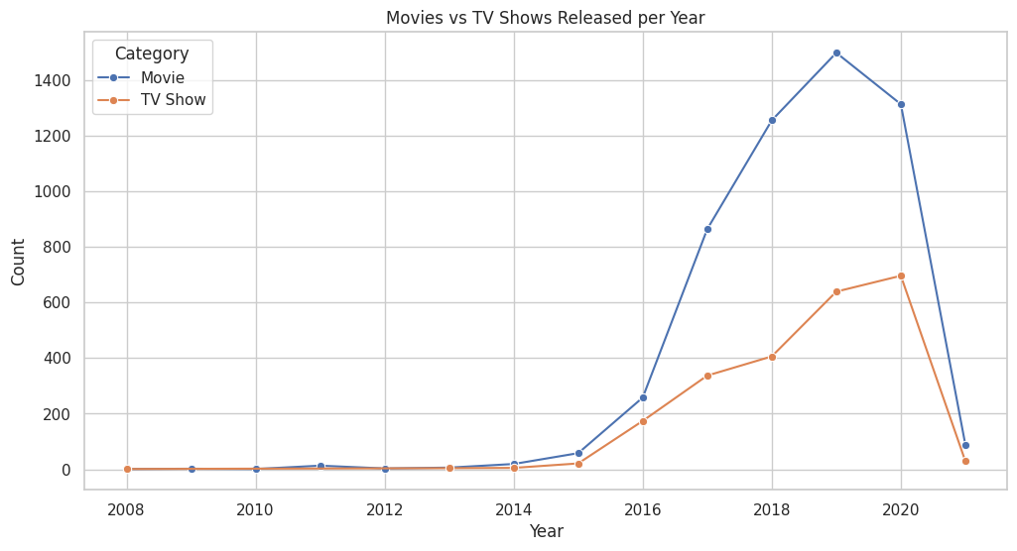
RESULTS1

Slide 7
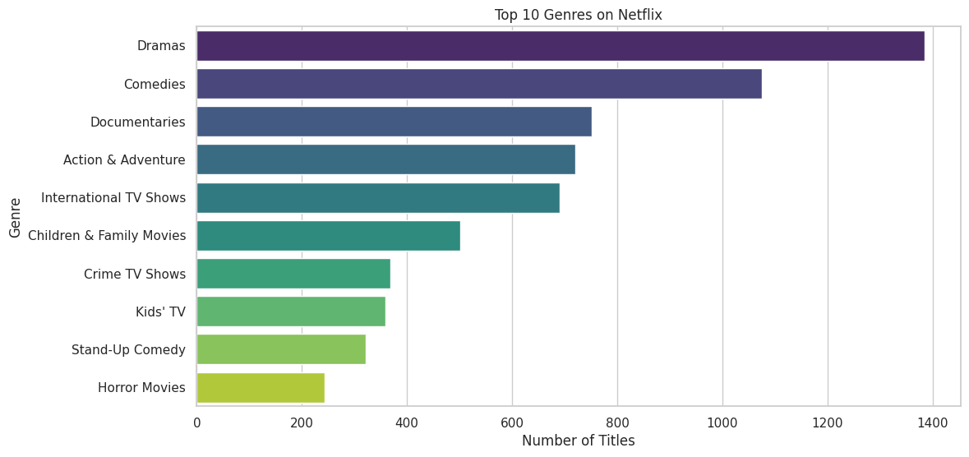
RESULTS2
[Add screen shots of your code or Chart(s) ]

Slide 8
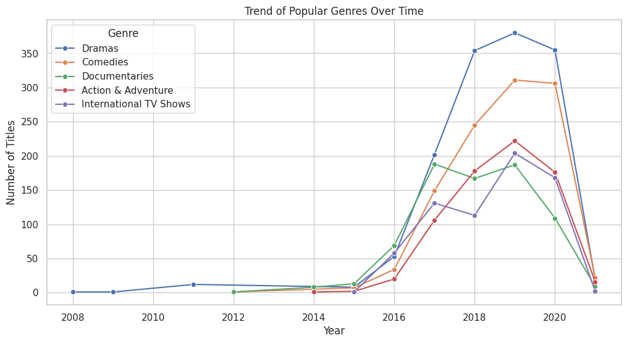
RESULTS3
[Add screen shots of your code or Chart(s) ]

Slide 9
GitHub repository
https://github.com/Umaralp/VOIS_AICTE_Oct2025_MajorProject_Junaid-Umar

Slide 10
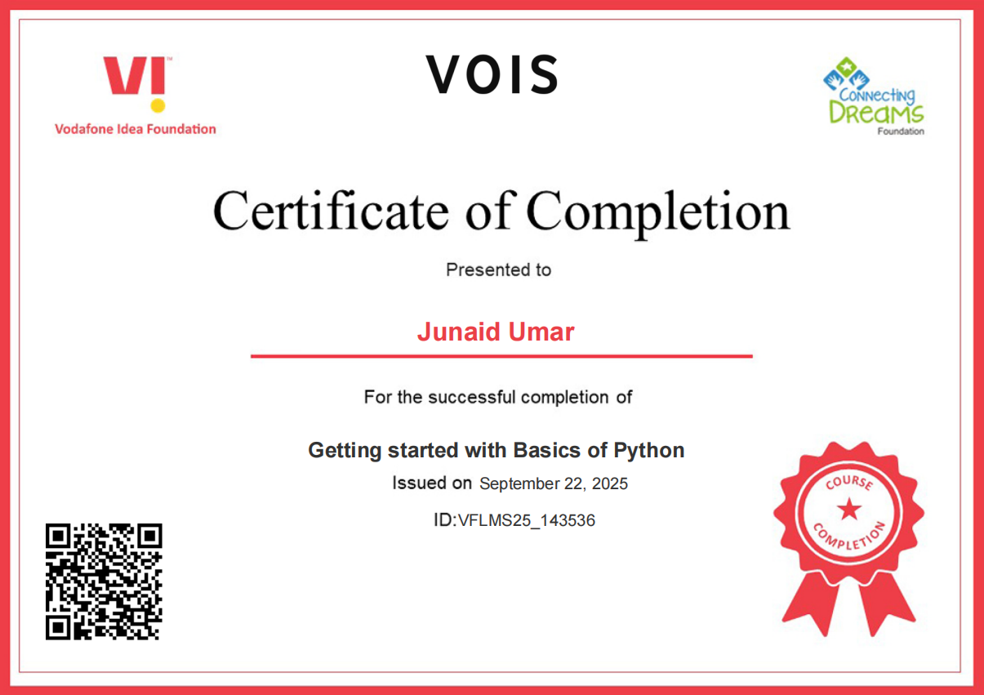
Getting started with Basics of Python Certificate

Slide 11
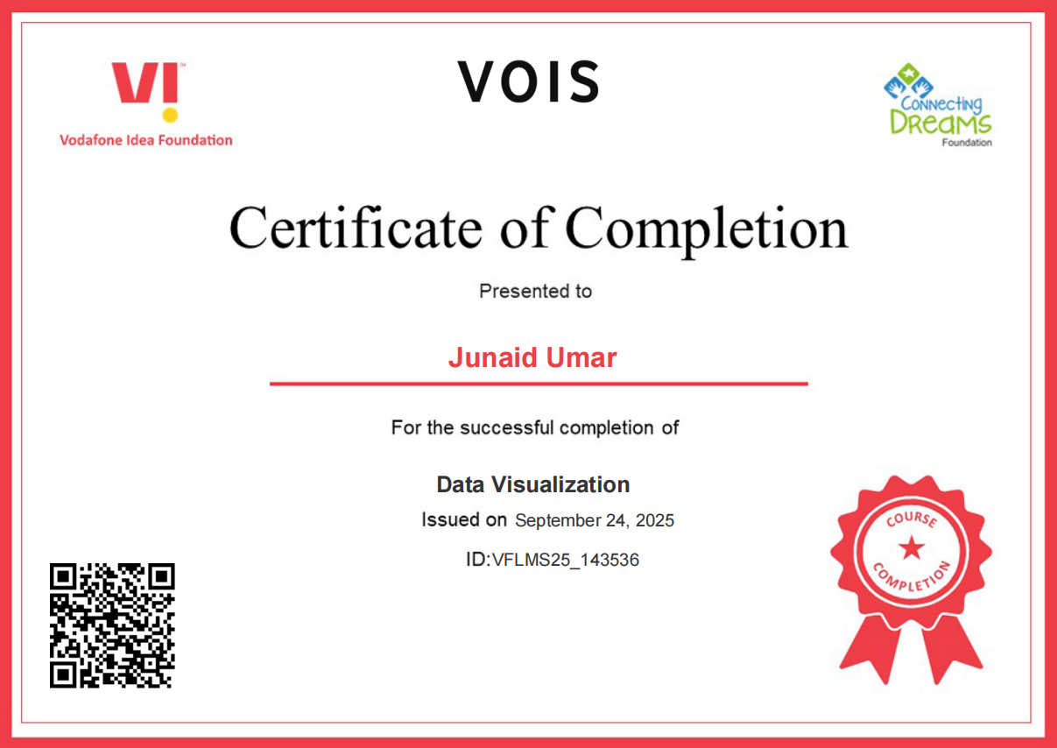
Data Visualization Certificate

Slide 12
Thank you
.
.
.

